Slide 1
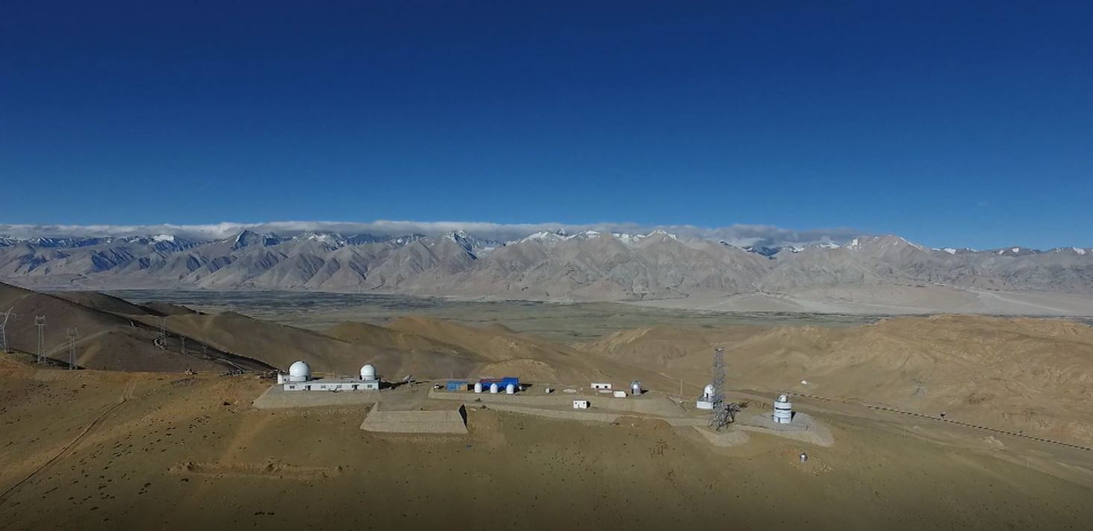
Monitoring techniques and methods of atmospheric conditions at high altitude observatories above the Tibetan Plateau
Yongqiang Yao
National Astronomical Observatories,
Chinese Academy of Sciences
2024.09.1-7 @ BSFP-2024, Irkutsk

Slide 2
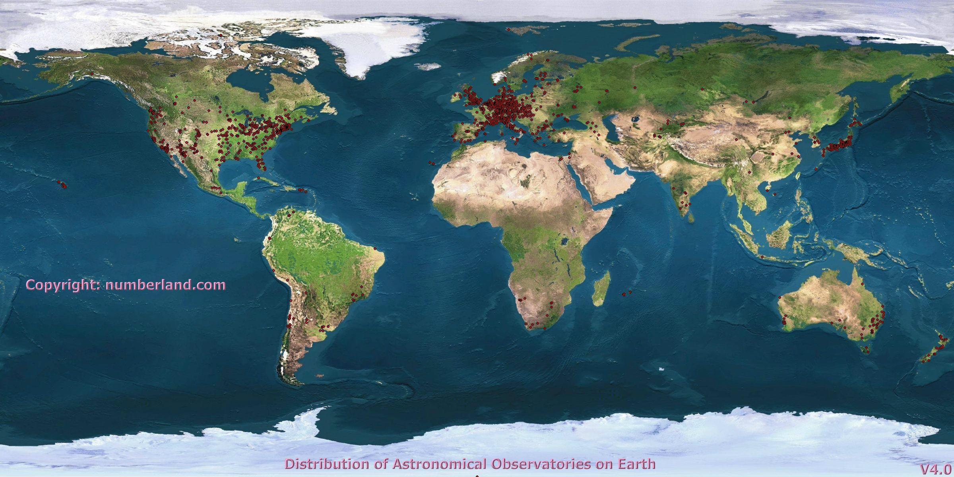
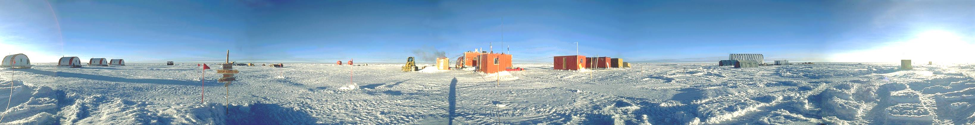
Original intension: site survey for excellent observatories
Globally few sites satisfying strict criteria for large aperture telescopes
Maidanak
?
La Palma
Hanle
Mauna Kea
Paranal
La Silla
Dome C
Antarctica

Slide 3
Research objectives:
More demanding science drivers for new facilities
- Competition from space (sensitivity, resolution, wavelength)
- Frontiers of sciences move forward
Challenges of technological advances
- AO，Opt~IR interferometry, Submm techniques
- Technologies allow large aperture telescopes >> 10m
- Multi-discipline application, such as satellite communication
Requirements:
Atmosphere must be known greatly in detail
- r₀, theta, tau, no longer suffice
- C_{n}², L₀, l₀, windspeed, pwv as f(h,t)
All-round cooperation to identify & protect world-class sites

Slide 4
Outline
I. Introduction
Atmospheric effects on astronomical observations
Advantages of high-altitude sites
Site survey in west China
II. Techniques and methods related
Remote study and campaign
Site monitoring and evaluation
WRF models for atmospheric condition
III. Summary and further work

Slide 5
I. Introduction
Atmospheric effects on astronomical observations
Advantages of high-altitude sites
Site survey in west China

Slide 6
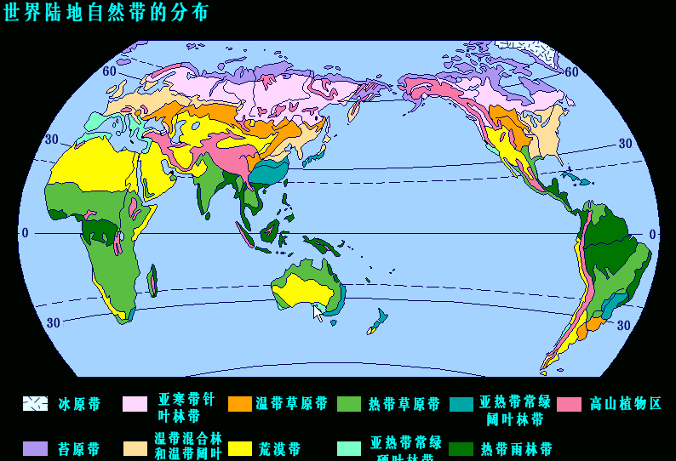
- Astronomical Climate
Solar radiation, atmosph. circulation,
land sea distrib., ocean currents, high-altitude terrain
⊙
⊙
⊙
⊙
▽

Slide 7
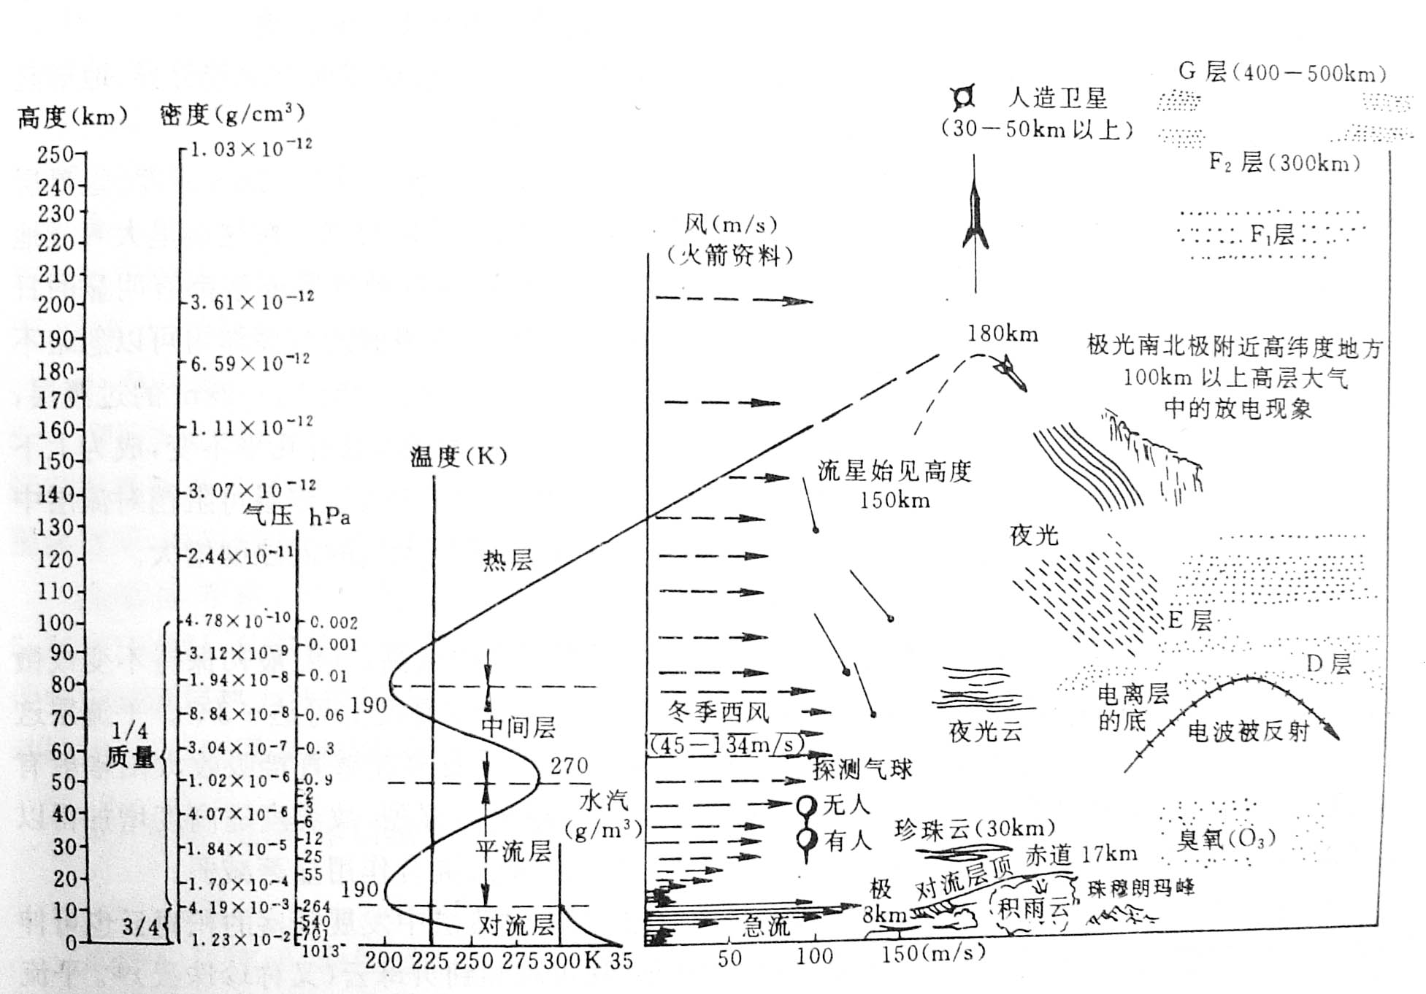
- Atmospheric effects on astronomical observations
absorption
  O₂ , O₃ in UV,
  H₂O , CO₂ in IR
  particles, Opt~UV
radiation & scattering
  - upper fluorescence
  - thermal radiation
  - sunshine/moonlight
  - ground heat
  - scattering
  - artificial light
refraction
  - dispersion
  - seeing

Slide 8
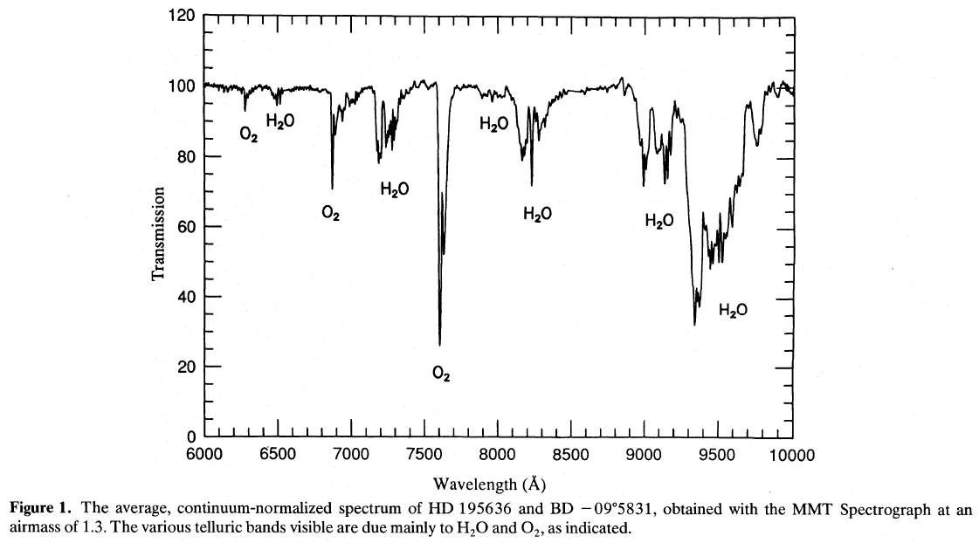
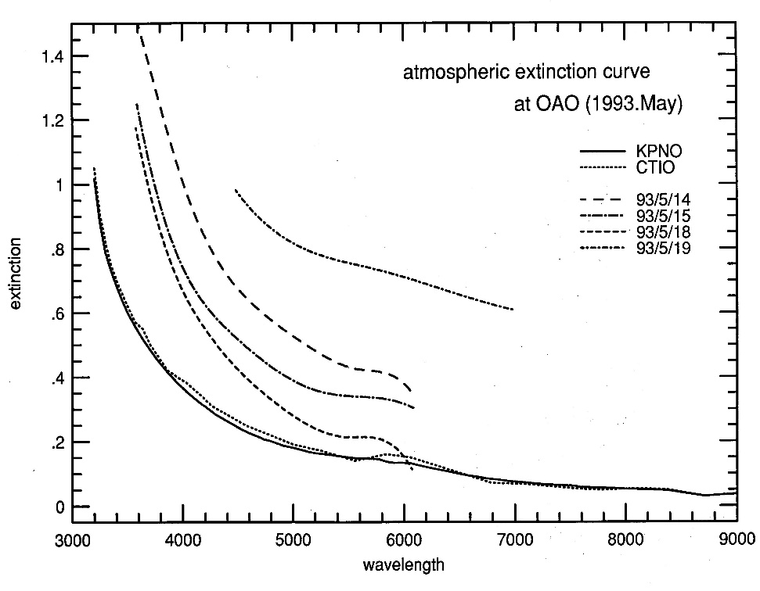
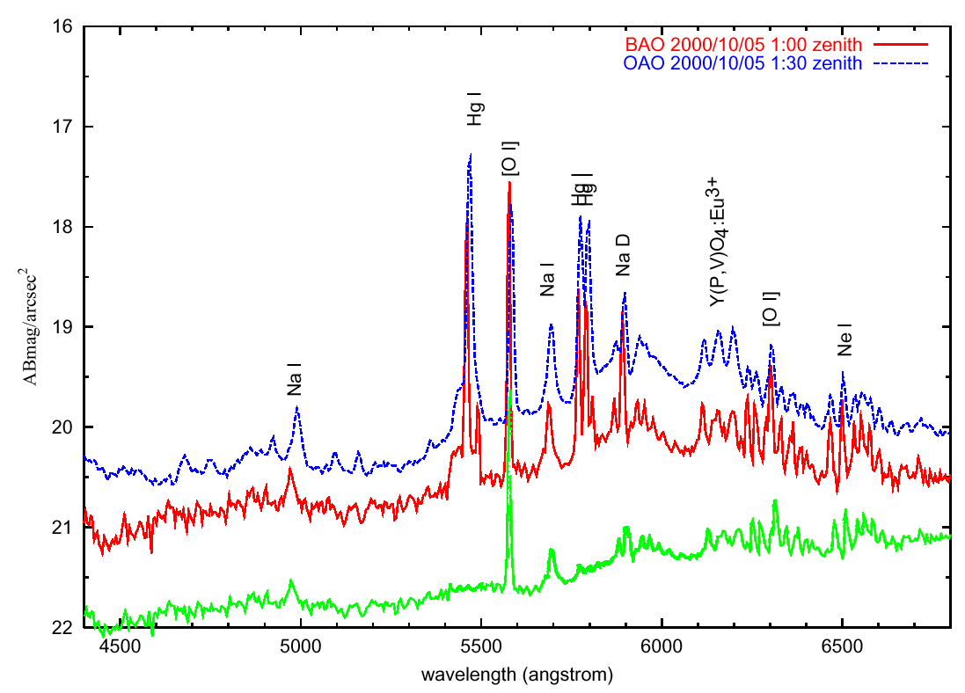
- extinction and emission in the visible
Natural sky

Slide 9
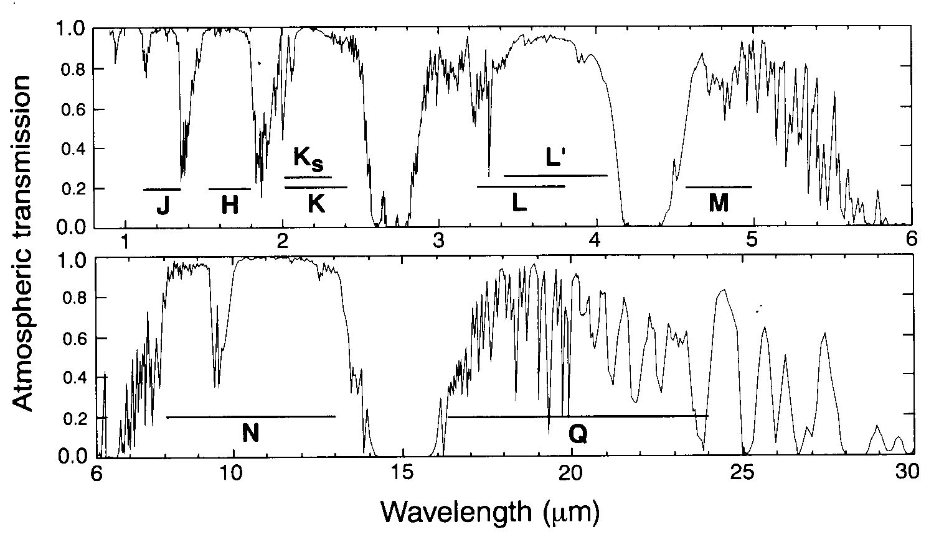
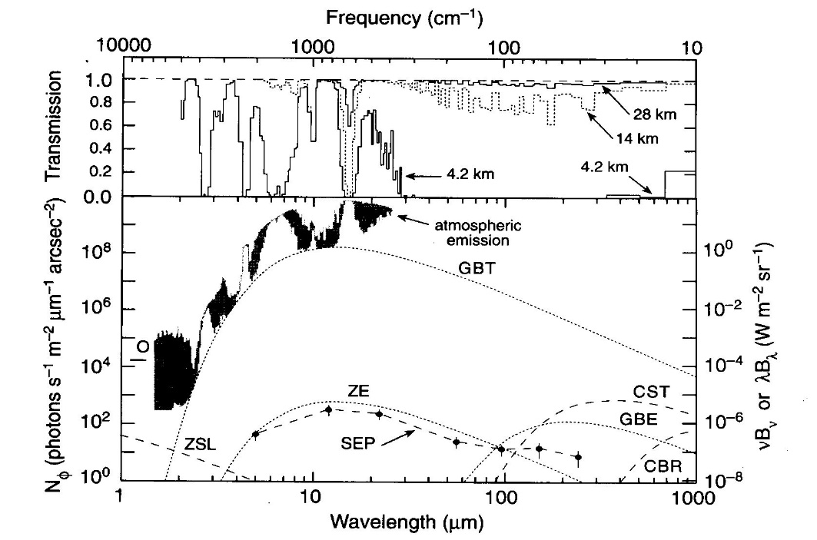
- absorption and radiation in the infrared
Water Vapor
OH
thermal
NIR
MIR
FIR
Sub-mm

Slide 10
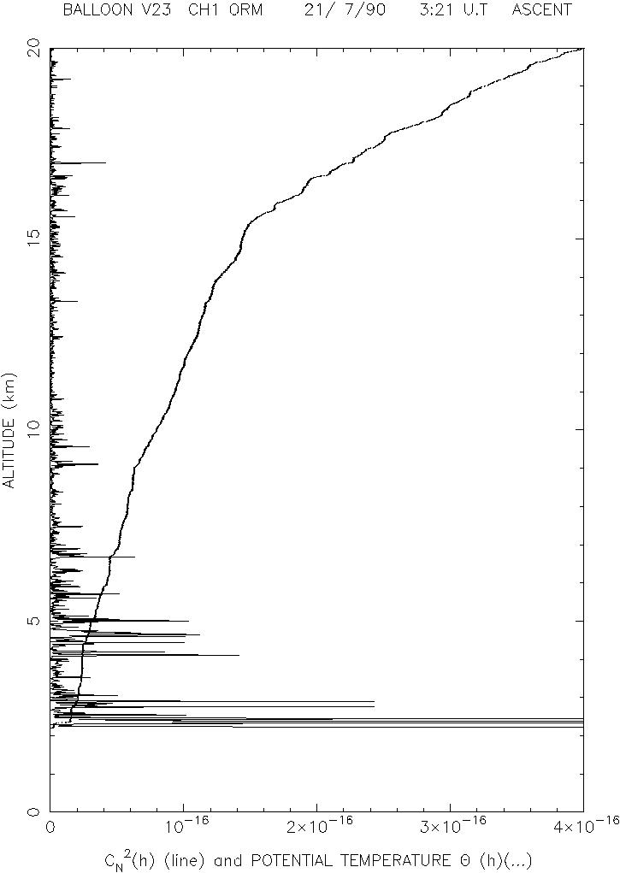
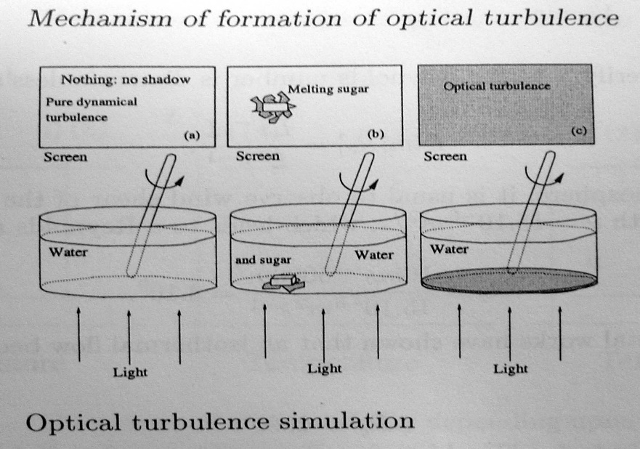
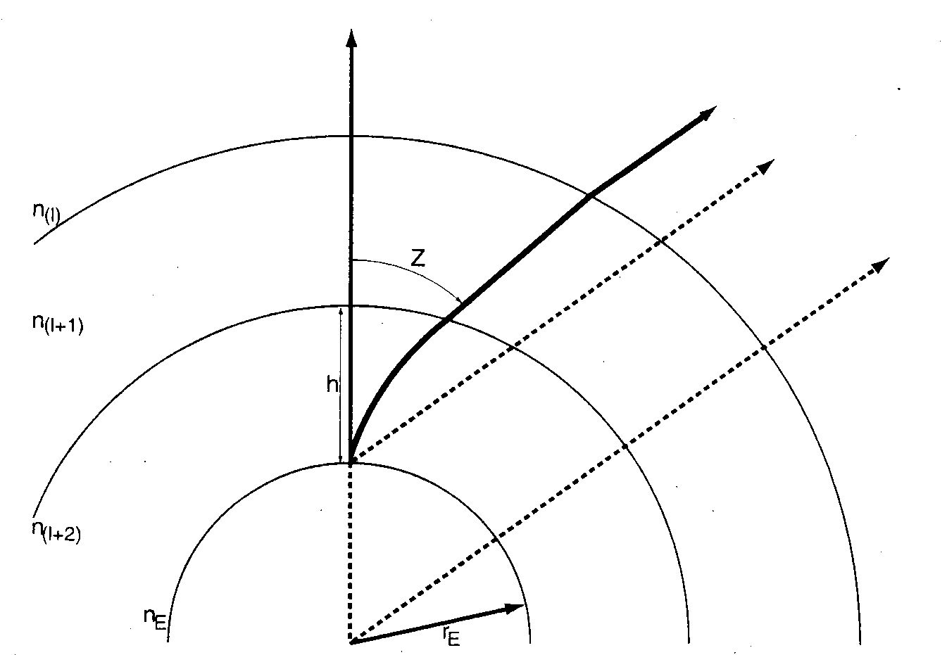
- effects of refraction
Atmospheric optical turbulence
Atmospheric refraction and dispersion
visual
real
Tropospere: n = 1+77.6(1+7.52x10⁻³λ⁻²)(p/T)x10⁻⁶;
Re = E_{k}/E_{ν} = UL/ν
↓ = 10m/s 5000m / 15.10⁻⁶ m²/s = 3.10⁹;
Optical turbulence: scintilation, jitter, beam spreading
Z＝60°3500Å-1μm, a difference up to 2.5 arcsec ↓
Serious impact on high resolution / wide range obs.

Slide 11
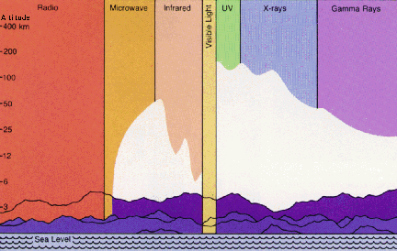
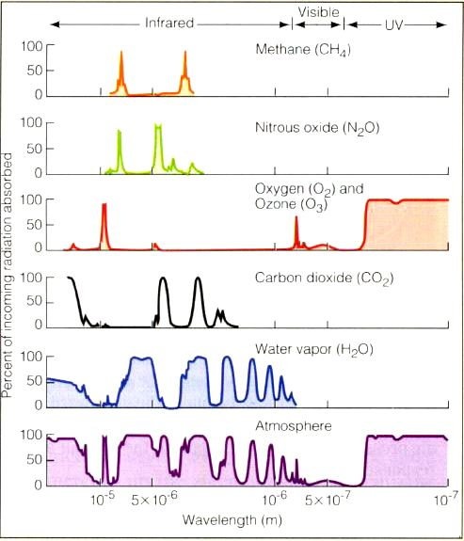
- advantages of high altitudes
Observatories of the World
____________________________________
Altitude Obs. Telescopes
range 2.2-3m 3-6 m >6m
________________________________________
>4000 m 9 1 3 4
3000-4000m 12 0 1 0
2000-3000m 68 9 9 10
1000-2000m 107 4 2 0
0–1000 m 1002 2 0 0
________________________________________
References:
http://www.ipa.nw.ru/PAGE/EDITION/RUS/AE/observatories.txt
http://www.seds.org/billa/bigeyes.html
turbulence intensity decreases with height
scattering light decreases with height
absorption significantly decreases with altitude
radiance significantly decreases with altitude
Earth’s atmosphere absorbs light
Water vapour absorbs IR to mm
IR radiation is absorbed mostly by water vapour, also by CO₂, O₂, N₂O, and CH₄
UV radiation is absorbed by O₃ high up in the atmosphere

Slide 12
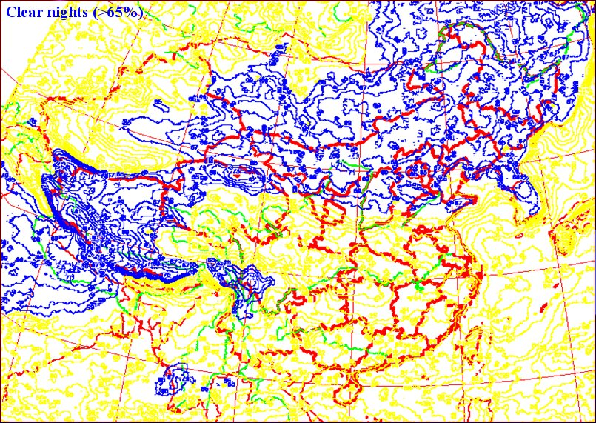
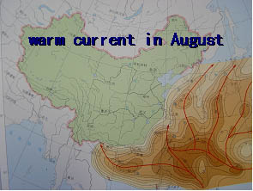
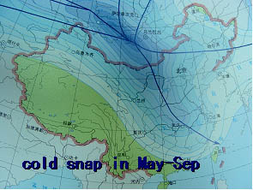
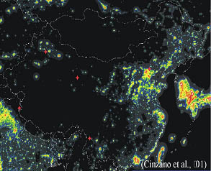
- site survey in western China
High plateau in west China,
Turbulence weakened with altitude
Scattering, absorption, & emission decreasing with altitude
Air clean, dilute, cold, dry, dark & quiet

Slide 13
II. Techniques and methods related
Remote study and campaign
Site monitoring and evaluation
WRF models for atmospheric condition

Slide 14
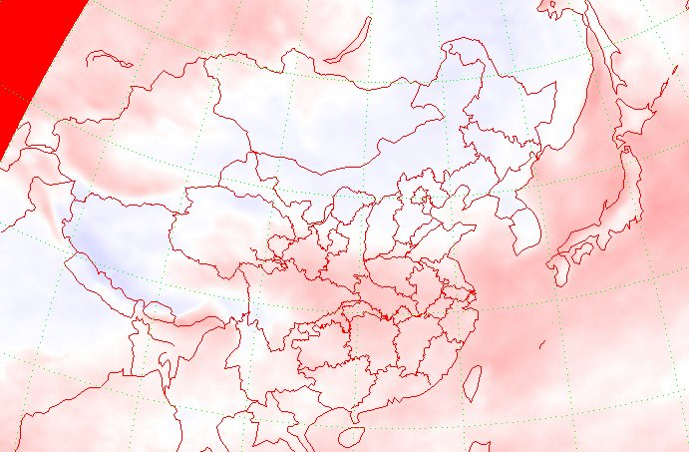
Remote study – Clear nights
Probability distribution of astronomical clear nights (Mao et al. 2004)
GMS + NOAA 1996 -2003, 1 pic/hr, total 43766 pics, Resolution: 12 km × 12 km
天文夜晴空概率
>70%

Slide 15
Remote study - Cloudiness
1961~2008 average 02:00 cloudiness

Slide 16
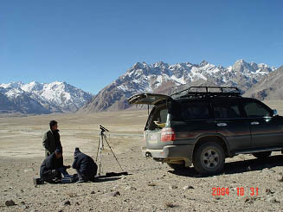
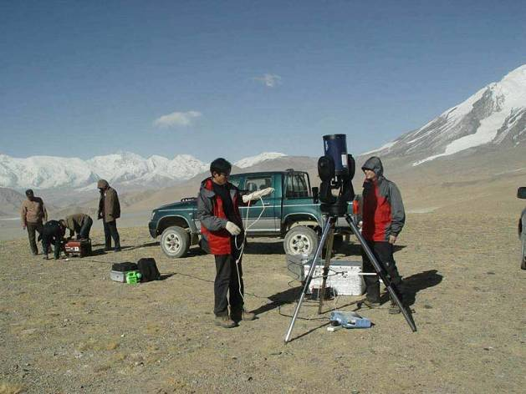
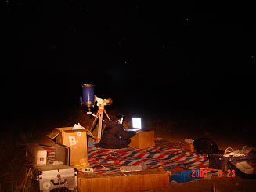
Remote study - vapor pressure, ground wind speed
average 1961~2008
average 1961~2008

Slide 17
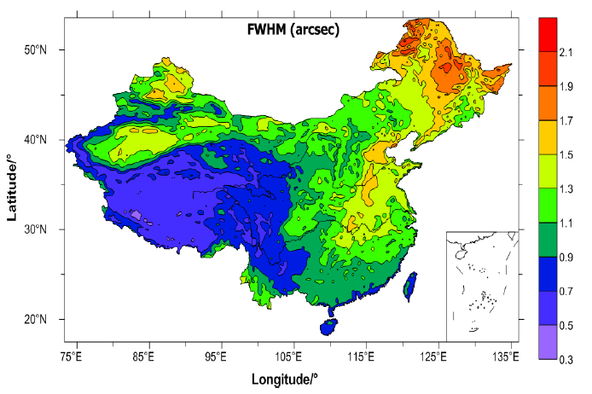
Remote study - Seeing
2010 average seeing over China

Slide 18
II. Techniques and methods related
Remote study and campaign
Site monitoring and evaluation
WRF models for atmospheric condition

Slide 19
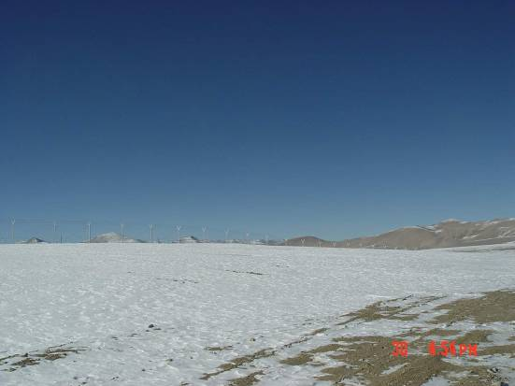
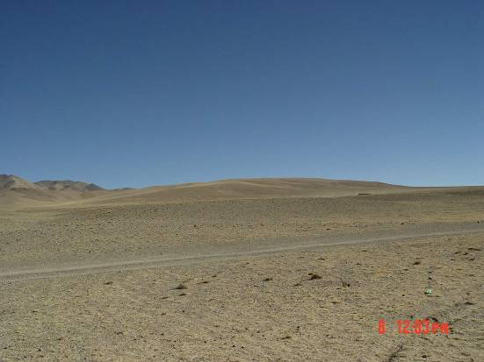
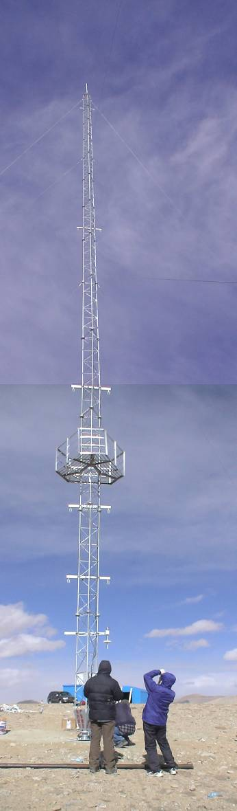
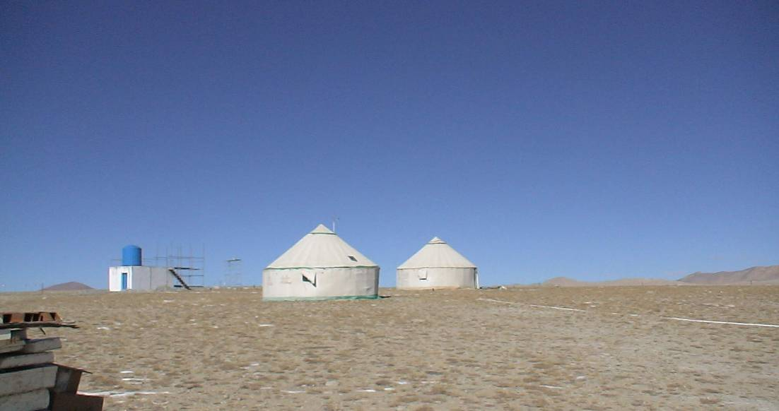
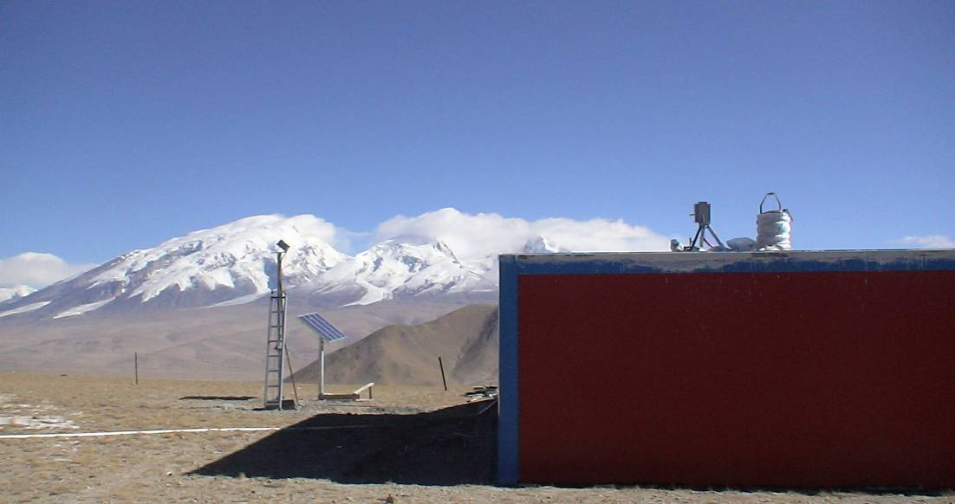
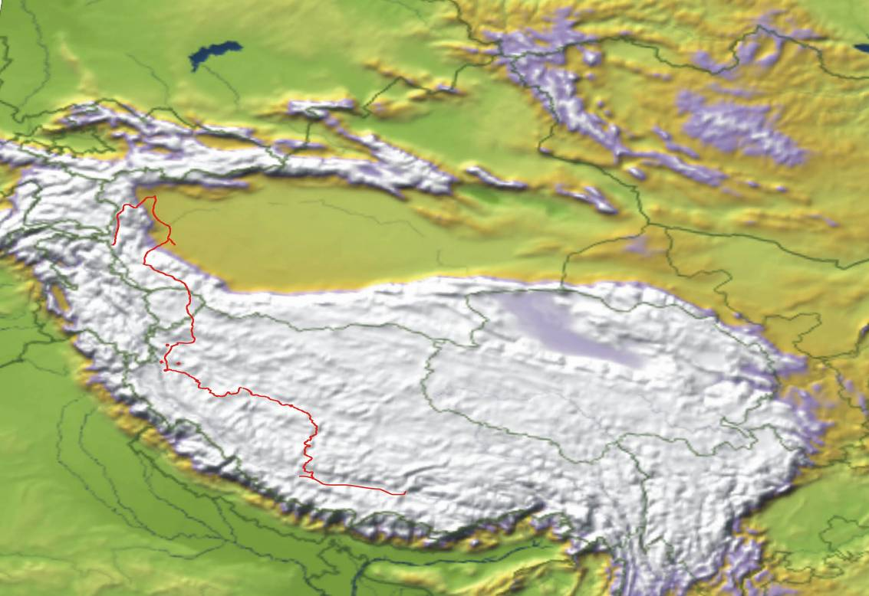
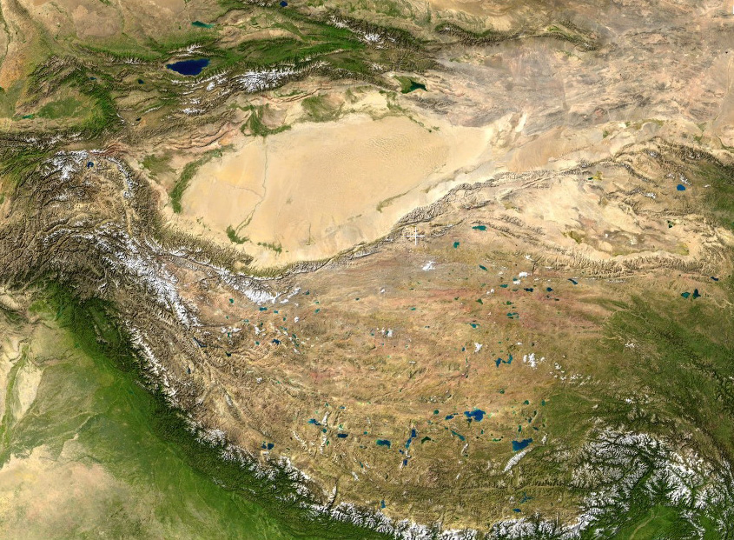
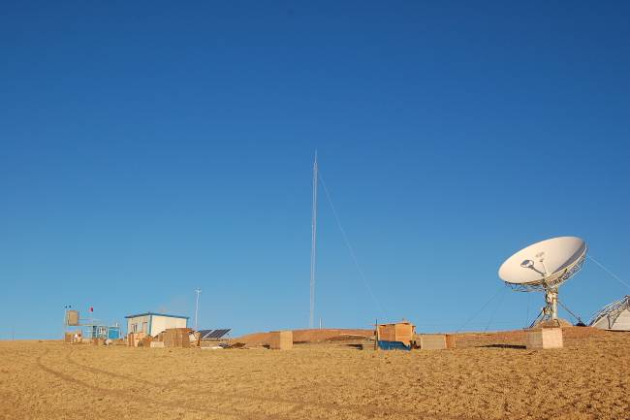
- site survey in western China
site monitoring for years
2007.10 Karasu
Karasu 4500m
Oma 5000m
⊙
2008.11 Oma
Karas
喀什
airport &
train station
⊙
Karasu: N38 10 E74 48, 4500m
←
⊙
叶城
⊙
Oma
阿里
⊙
airport &
train station
airport
Oma: N32 32 E83 03, 5100m
⊙
→
措勤
拉萨
⊙

Slide 20
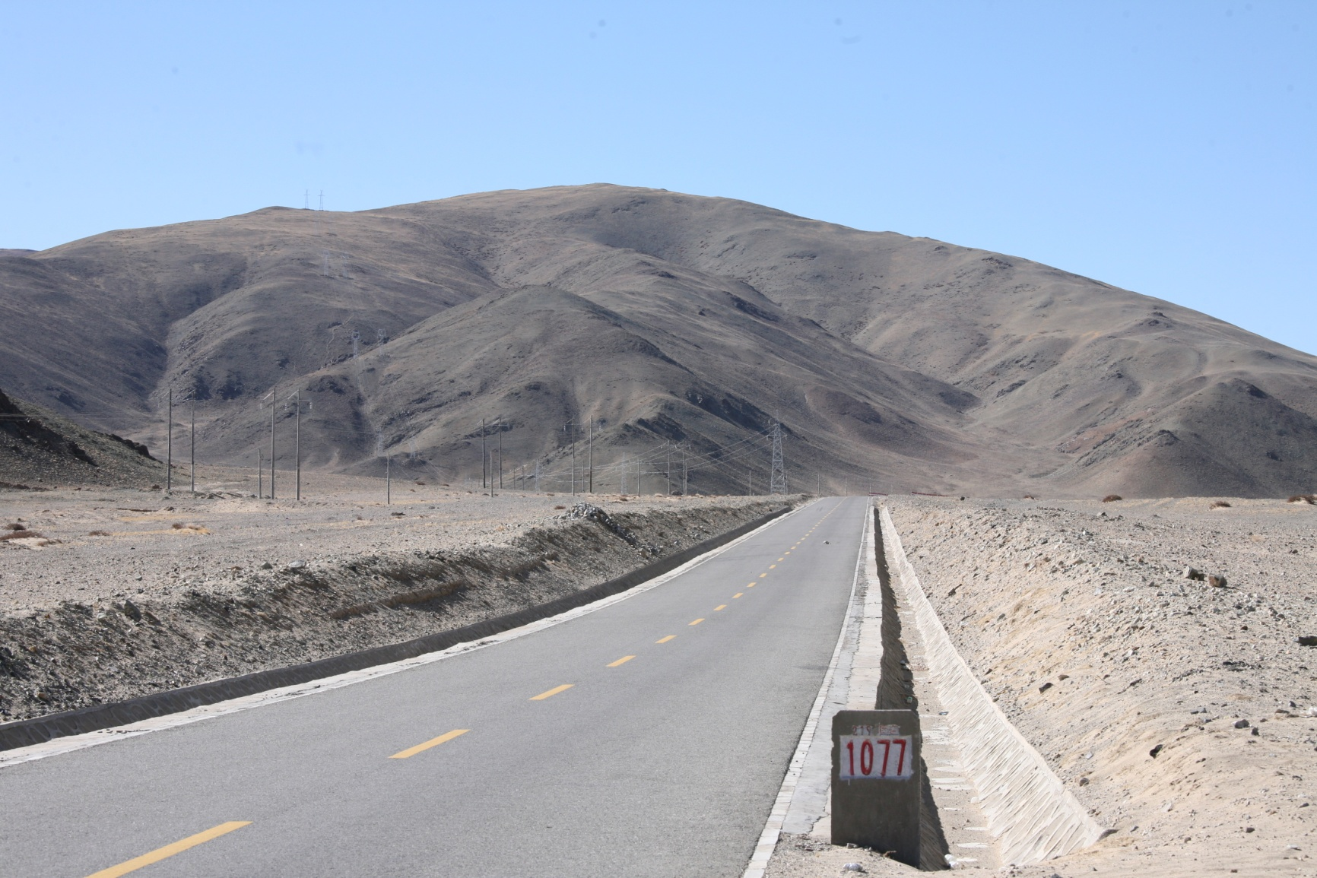
- site survey in western China
Final choice --- Ali site for site characterization and small telescopes
E80.05, N32.31
nearby a central town
Topography | A NW-SE ridge, above 5000m
Meteorology | Cloudiness and wind speed may be better than Oma
Traffic conditions | Paved road and airport from Lhasa or Kashi
Road to summit | Simple constructed
Electric power& commun. | Pass-way on summit to the airport
Geology for construction | Bed rock underlying less than 1m, common solidity

Slide 21
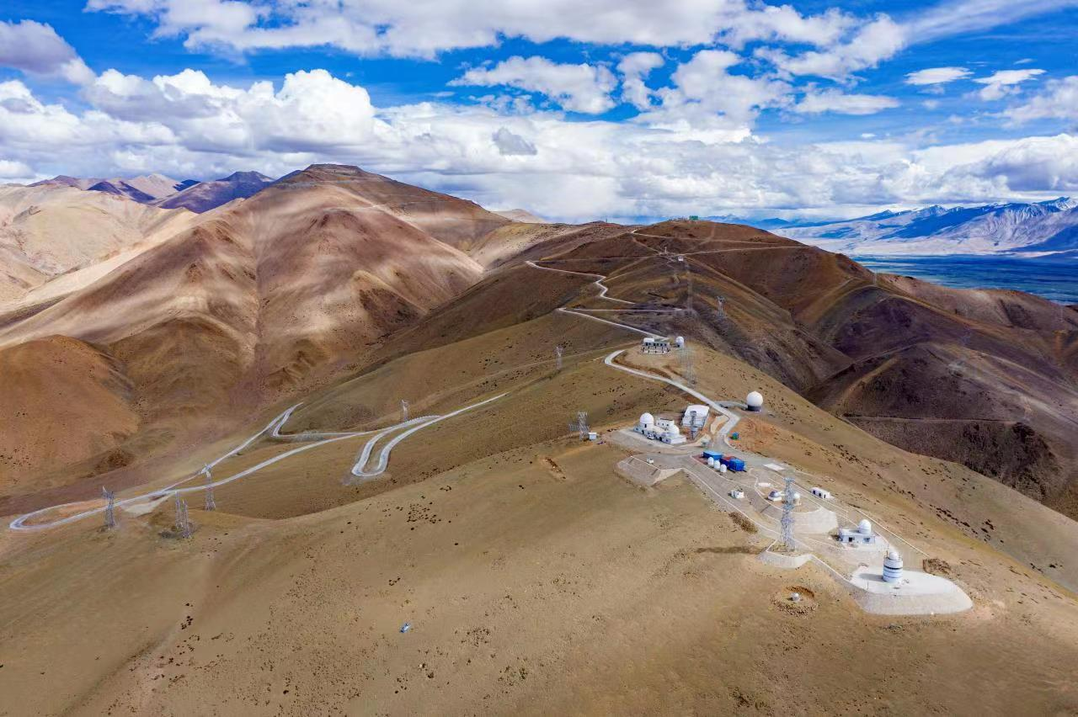
Ali Observatory: ridges A, B and peak C
C1
B1
B3
B4
A2
A1

Slide 22
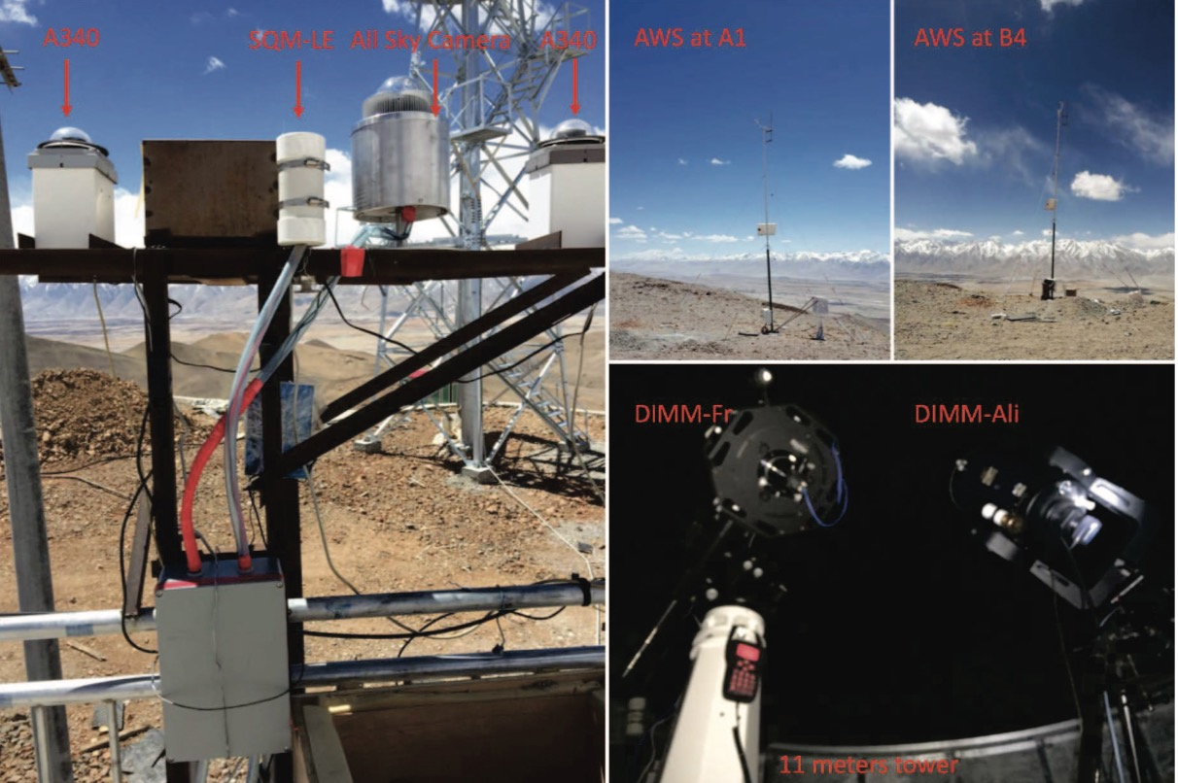
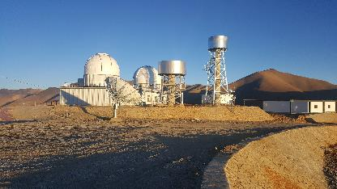
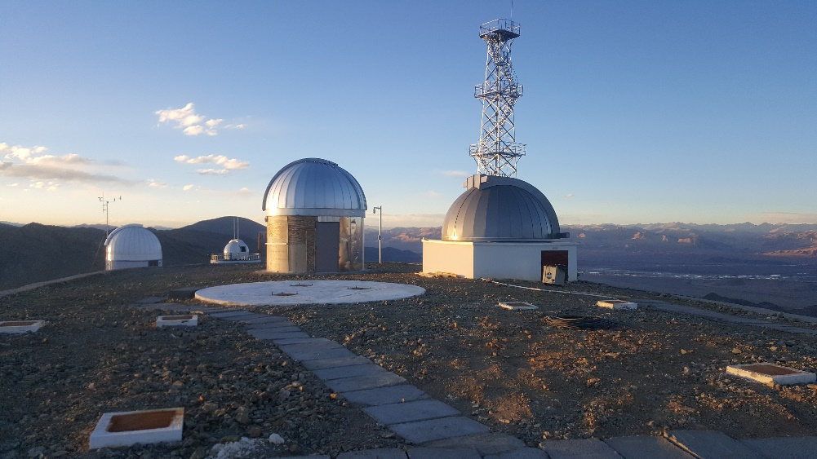
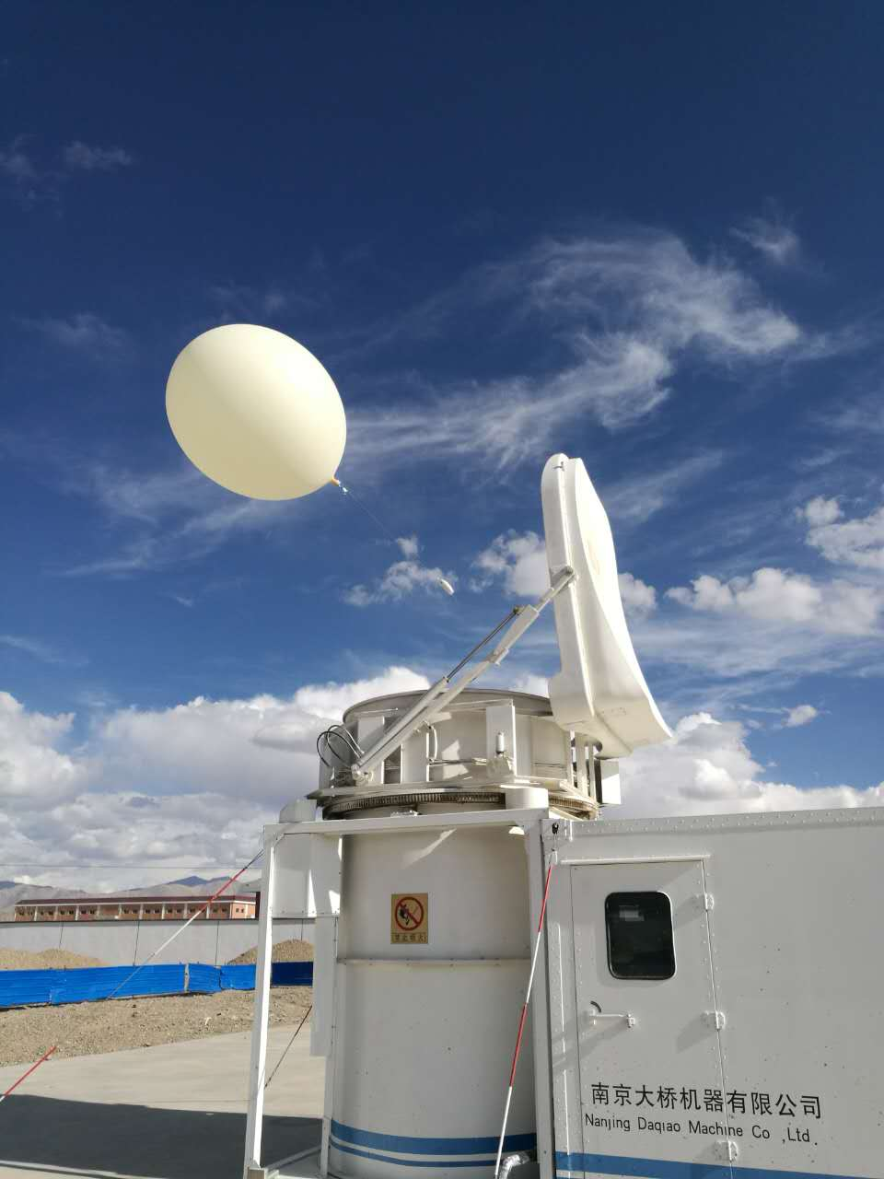
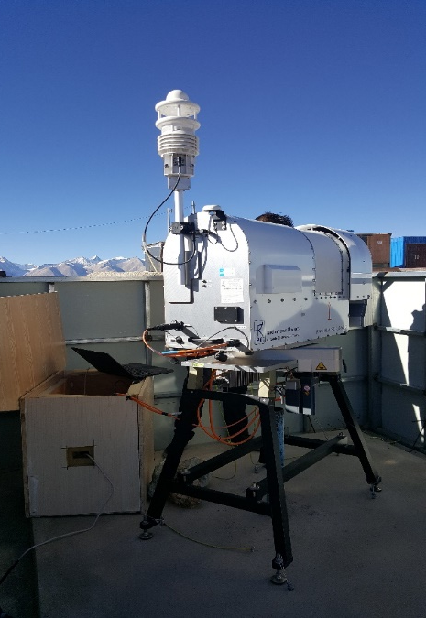
Site monitoring keeps going at Ali observatory
DIMM seeing tower
Super sonic tower
Radiosonde
RPG PWV measurement

Slide 23
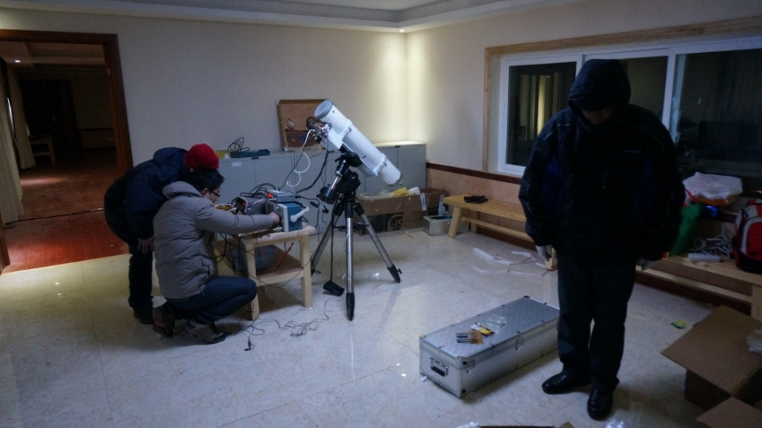
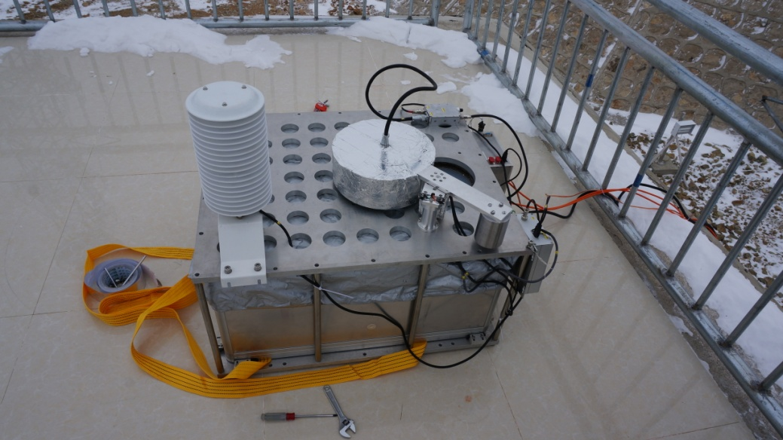
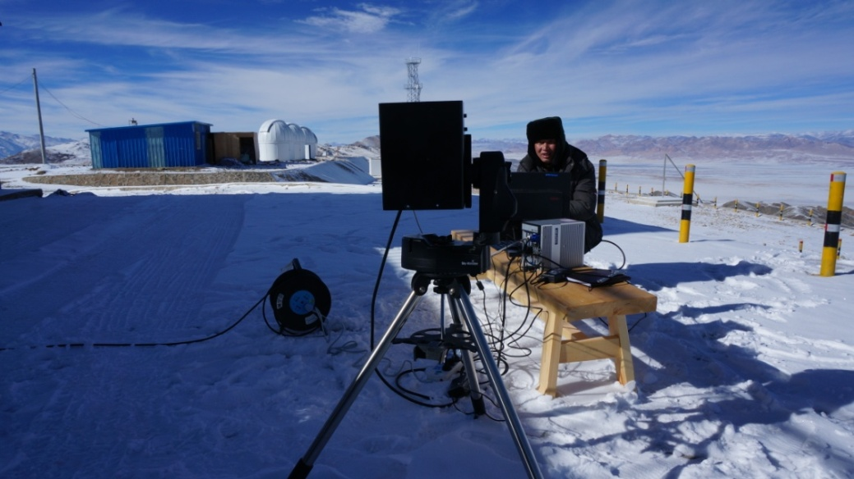
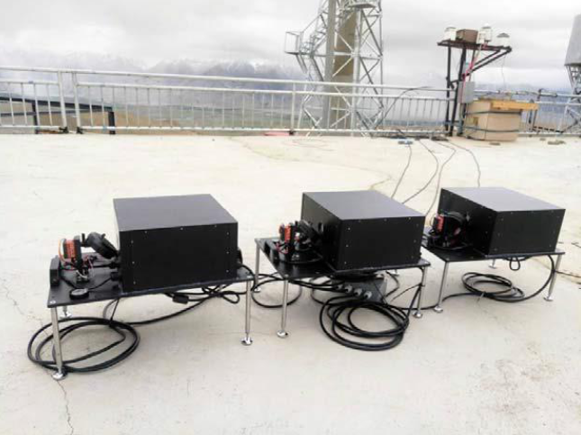
Site testing campaign at Ali obsevatory
Infrared measurement for solar telescope
Submm measurement for atmospheric absorption
Infrared measurement for cloudiness and background
Infrared sky background brightness (J-H-K)

Slide 24
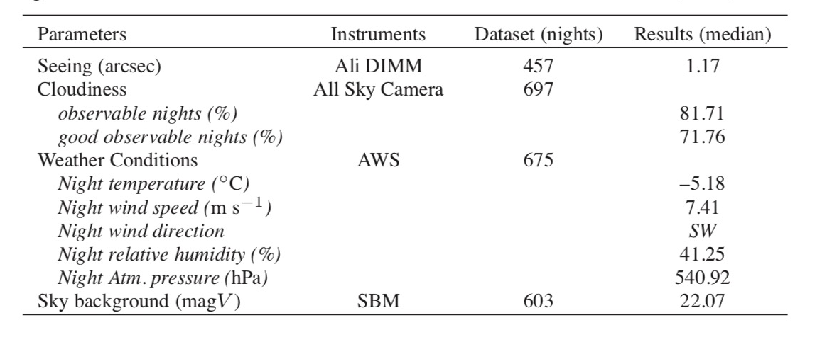
- atmospheric conditions at Ali observatory
The statistics of site monitoring at A1 point, Ali observatory, March 2017 to March 2019

Slide 25
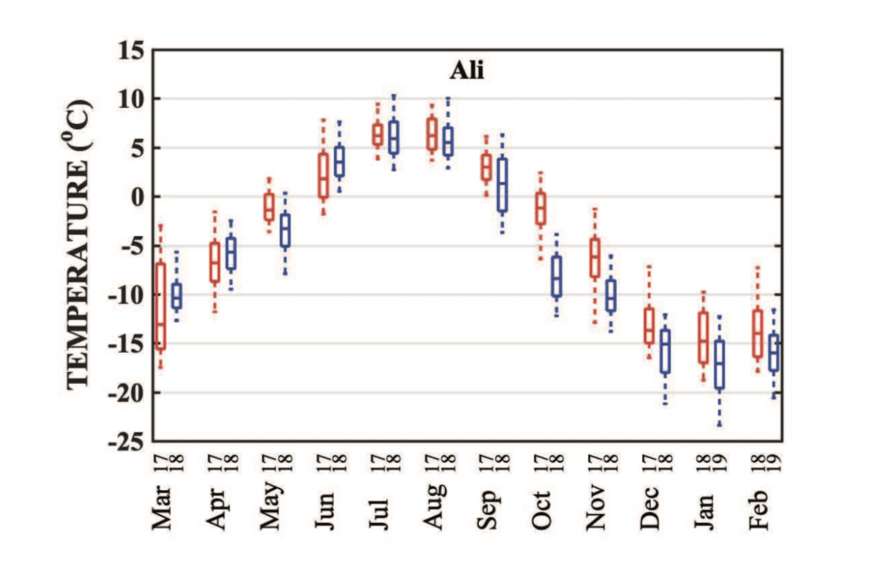
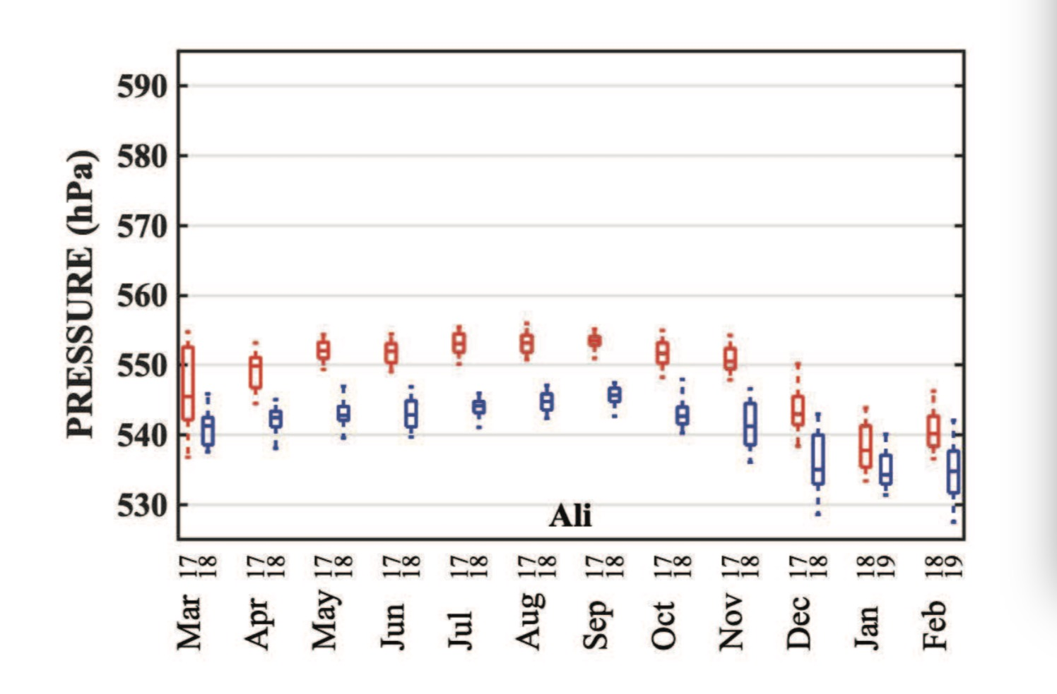
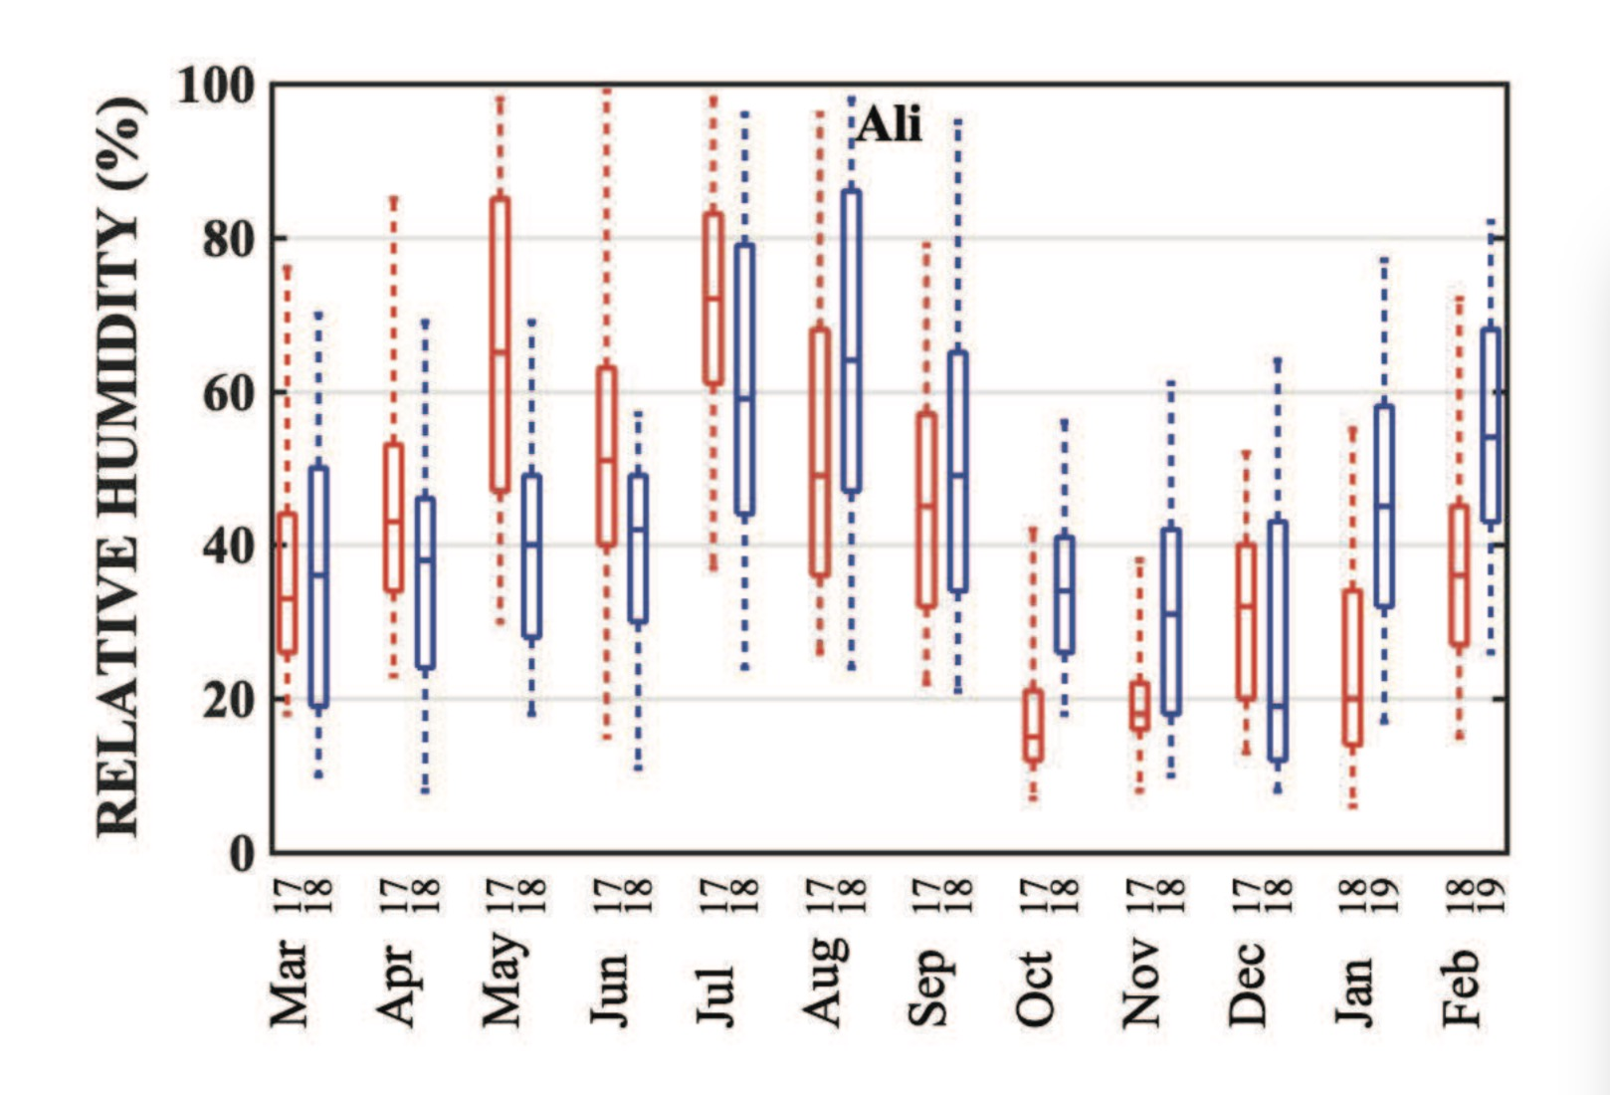
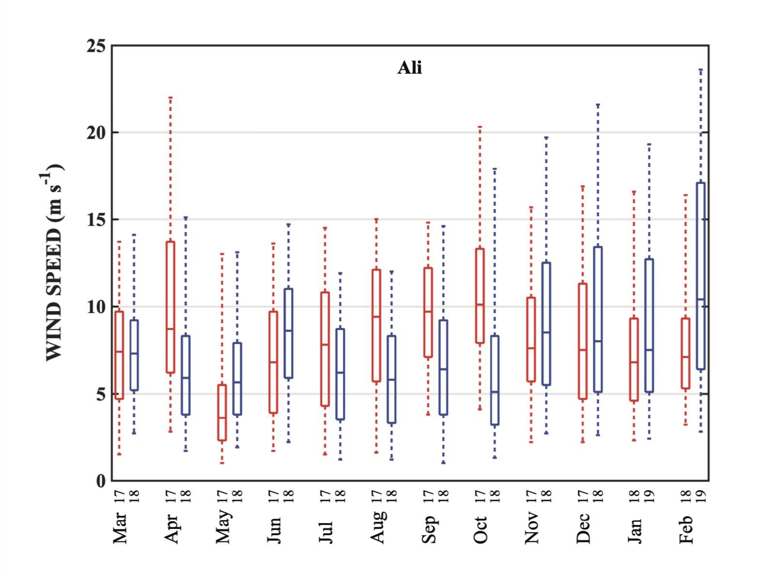
The night-time temperature, humidity, and wind speed; red: 2017-2018, blue: 2018-2019

Slide 26
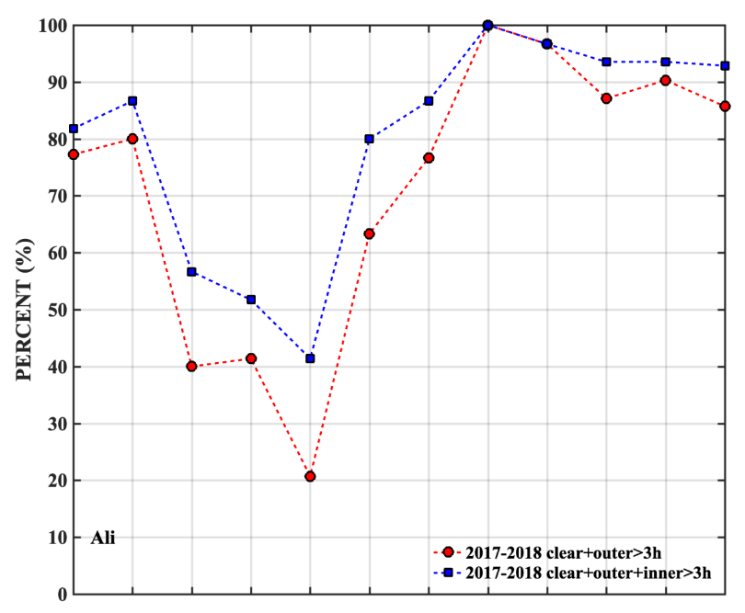
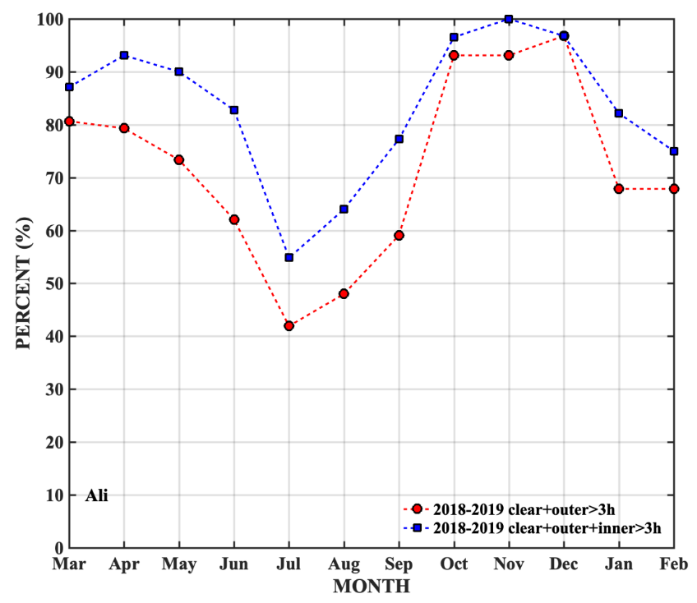
Percentages of clear nights; blue: observable , red: good observable nights.
2017-2018
2018-2019

Slide 27

Seeing statistics at A1, Ali observatory; red: 2017-2018, blue: 2018-2019

Slide 28


The PWVs in Nov. 2021 at B1, Ali observatory
Month | All | Night | Night + LWP
Nov | 0.72 | 0.72 | 0.68
Dec | 0.64 | 0.65 | 0.64
Jan | 0.87 | 0.82 | 0.85
Feb | 0.81 | 0.76 | 0.73
Mar | 0.98 | 0.97 | 0.87
Apr | 1.82 | 1.65 | 1.55
Month | RPG Median | MERRA2 Median | Radiosonde 7:00 | Radiosonde 19:00
Nov | 0.72 | 1.05 | 1.24 | 1.13
Dec | 0.64 | 0.81 | 0.63 | 0.48
Jan | 0.87 | 0.81 | 0.56 | 0.61
Feb | 0.81 | 1.04 | 0.58 | 0.65
Mar | 0.98 | 1.39 | 1.43 | 1.37

Slide 29


The PWV statistics at Ali A1-point,
during the 2022-2023 winter season
The monthly and annual mean profiles of PWV
by radiosonde

Slide 30





- site evaluation of Ali observatory
EAO team, leading by former IAU President, Norio Kaifu, in June 2013
LOT site evaluation team in June 2017
CMB team in July 2017
SNODAR team in April 2018
LuSci team in May 2018

Slide 31




- site evaluation of Ali observatory
SCIENCE, 2012
EACOA Site Survey Workshop in April 2012
Review of potential sites for the Large Optical/infrared Telescope(LOT) in June 2017

Slide 32



Paul Hickson & Marc Sarazin
--- LOT site review panel report

Slide 33



Slide 34





Slide 35
II. Techniques and methods related
Remote study and campaign
Site monitoring and evaluation
WRF models for atmospheric condition

Slide 36




- Atmospheric conditions with WRF model
for various parameters, with a horizontal resolution~1km,
vertical~ 35 layers from ground to 20hPa; time interval: 0.5~1 hour.
Instruction for site survey at the beginning

Slide 37




Evaluation of site conditions with WRF model

Slide 38



Research on profiles of atmospheric optical characteristics
PWV
wind speed
C_{n}²
Xuan Qian, et al. Validation of the WRF Model for Estimating Precipitable Water Vapor at the Ali Observatory on the Tibetan Plateau. 2020, PASP, 132:125003
Notes:
在引力波、毫米/亚毫米等观测中，水汽的影响至关重要。
利用数值模式输出的各个高度上的水汽参数，可获得水汽的积分总量 、以及地面-高空的水汽廓线垂直分布。
通过与探空结果的对比，模式计算的水汽结果具有很好的一致性
表中给出了阿里站探空观测、模式计算、及利用地面气象站数据计算获得的水汽结果，具有很好的一致性
其中，利用地面气象站数据计算水汽，简单介绍下这个方法

Slide 39


Instruction to Ali site development

Slide 40






Prediction of atmospheric optical characteristics

Slide 41
III. Summary and further work

Slide 42


- site development following the WRF model suggestion
Topography and site development
D-F

Slide 43






- Infrastructure and facilities
Shiquanhe, nearby city Ali airport Night-sky Park
Road and electric power construction to the ridges A, B, and peak C1

Slide 44






- Infrastructure and facilities
Quantum teleportation HinOTORI LCOGT Ali-knot
Photometry Array by Yunnan Univ.
Time-domain Obs.
of Nanjing Univ.
Satellite Commun.of Hualu
GW detection, B1
space debris, C1
+ 50 / 70 /80cm Telescopes of
- Beijing Planetarium,
- CAST Science Museum,
- Northern Corona Obs.

Slide 45






- Further work
Measurement of the C_{n}² profiles in surface layer, to improve understanding for the WRF local model;
Construction of the promising 6000m platform, to meet the requirement of higher altitude sites.

Slide 46
- summary
The high-altitude Ali observatory has been identified through long-term research, including remote study, site campaign and monitoring.
Ali observatory has excellent atmospheric conditions for astronomical observations, with rather good infrastructure and traffic condition.
Ali observatory is also a good platform for various atmospheric research and equipment development.
Site testing campaign and site development are continuously ongoing at Ali observatory, and any cooperations taking the site advantages are very much welcome.
Thank you.

